Slide 1

Redo log optimization
Oracle
Paweł Olchawa, Dimitri Kravtchuk, Marcin Babij, Debarun Banerjee,
Sunny Bains, Vinay

Slide 2
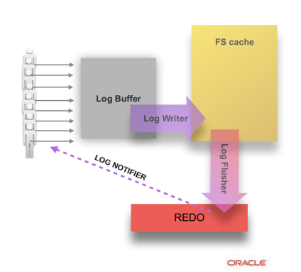
InnoDB – the new redo log

Slide 3

The mtr_commit() - the old and the new way

Slide 4
- Is there any queue around here?
- Take your number...
How did we relax the order by LSN (time) ?
Limited window for
pending operations (L)
All past tasks done
Wait (unlikely)
Pending tasks (in progress)

Slide 5
/* Create a new “light task” */
your_start_time = time_sequence.next_time(planned_time_interval);
/* Wait until it's permitted to start the execution (unlikely to wait). */
tasks_done.wait_until_in_current_window(your_start_time);
/* Do your work */
foo();
/* Report it's done. */
tasks_done.report_task_done(your_start_time,
your_start_time + planned_time_interval);

Slide 6
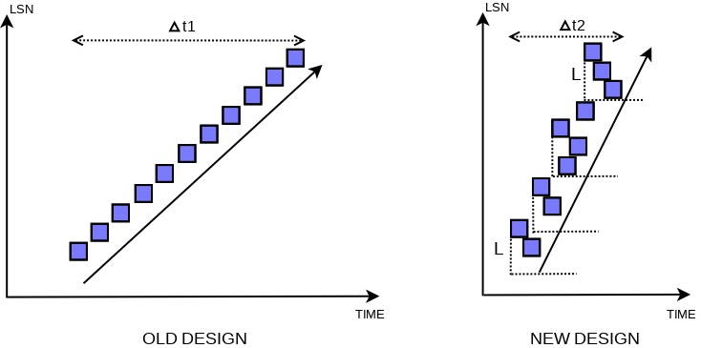

Slide 7
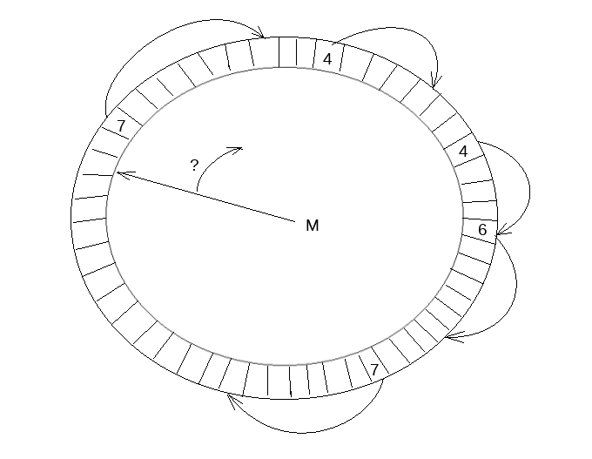

Slide 8
Adaptive waiting in redo threads
Spin-loop until you ran out of iterations limit.
  (how to set the limit ?)
Wait with a minimum timeout on pthread_cond_var.
  (what's the real minimum we could effectively get ?)
Each few waits, increase the timeout used for waiting
  (what's the overhead of the travel to wake-up queue ?)

Slide 9
OPEN QUESTIONS #1
How to do the adaptive waiting in log_writer / log_flusher / ... ?
How to measure what's the overhead of wait on pthread_cond_var with a given timeout ?
Did you consider an option to let know scheduler about some critical periods of execution ? (hint?)
Is there a way to disable preemption for threads which started but not finished their "light tasks" ? (such as preempt_disable()) ?
How could we force a proper scheduling for threads following the described pattern (create task -> work -> report task is done) and single worker threads (advance time such that all older tasks are done) ? Some temporal priorities across threads ?
Is there a way to force priority inversion other than by mutex usage? The worker thread, when unable to advance time, would ideally promote proper user thread (he has the knowledge of who should be next)

Slide 10
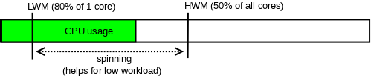
Waiting for written / flushed redo
1. Spin-loop (busy wait) unless we do not want to waste CPU on that.
2. Wait in proper bed.

Slide 11
N beds
users waiting
Redo log is divided into blocks of 512 bytes (and writes of complete blocks only are preferred over writes of incomplete).
We assign consecutive blocks to consecutive beds (and wrap):
bed = (lsn – 1) / 512 % N
Users waiting for flushed redo, select a proper bed to wait (each bed has cond_var).
When redo is flushed, notifier thread visits proper beds and wakes up user threads sleeping there.
False wake-ups are allowed (user will retry wait), but we may not miss required wake-ups.
Note, in the worst case, at most all beds have to be notified.

Slide 12
OPEN QUESTIONS #2
Is there a chance to optimize pthread_cond_var internals ?
Could pthread_cond_signal / broadcast be faster? async? (to avoid delay in thread which is notifying)
Could you try to optimize the wake up execution path / wait queues ?
How could we avoid those ugly spin loops ? If not avoid, how could we know how long should we spin on given system / arch (how long does PAUSE take, how busy is wait queue currently etc)
In “single" threaded workloads, when a single user thread and workers need to align their work, it is critical to utilize cpu by the user thread as much as we could. Delegation of tasks to be done is expensive (redo writer etc). Proxy execution seems a way to go. Could we hint scheduler and point on what should be executed next ?

Slide 13
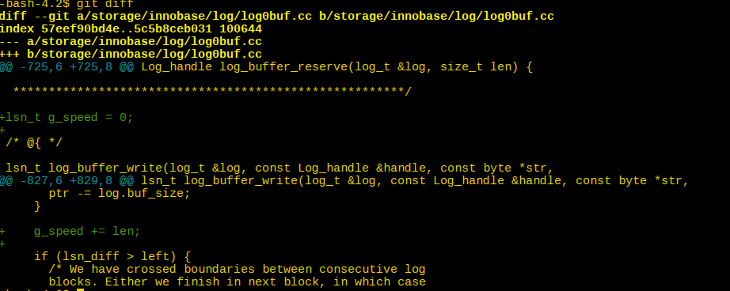
How to find out why this change optimized from 125k TPS to 160k TPS?

Slide 14
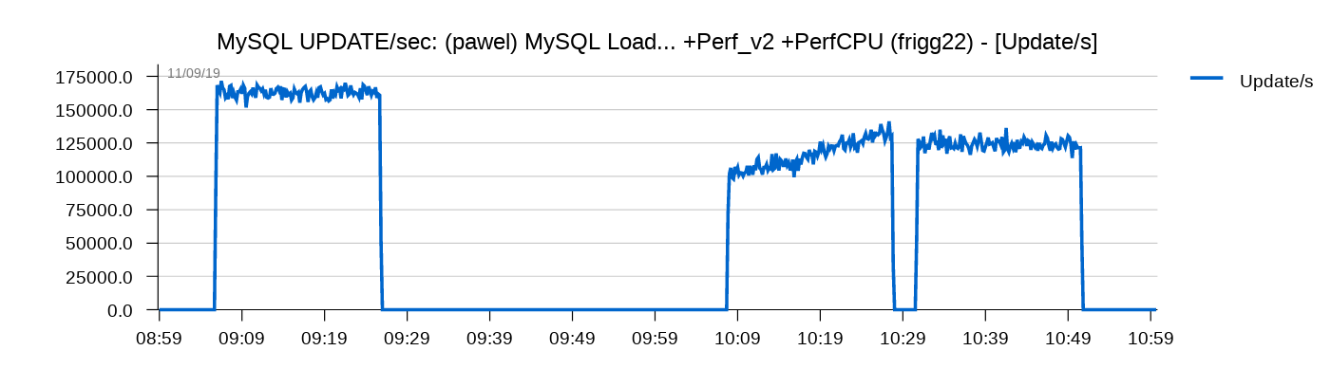
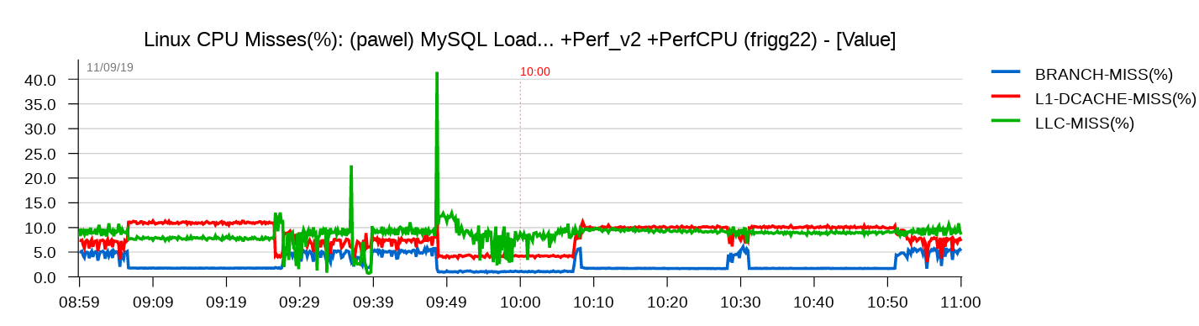

Slide 15
OPEN QUESTIONS #3
These events (dcache miss) are successful, but there is much more to observe in snooping / MESIF / etc.
Testing for various workloads, for multiple commits, for multiple hw, for multiple settings is already a lot of multiplied things to do. Looking at different sets of events (having limited counters) is yet more. There are hundreds of events. Is there a way to make it simpler for us ?
Could we agree on making some arch-specific memory events more generic so we could have a common set of events to monitor, no matter what CPU we are dealing with ?
There is a huge difference in impact of communication within socket vs communication across cpu sockets. Could we make easier to do monitoring of both types of communication ?

Slide 16
- Hey, I wanted to stop the world for a moment.
- Sorry, I'm lock free.
1. In very unlikely cases some thread might want to avoid any new mtr_commits.
2. We wrapped almost the whole mtr_commit with a sharded rw-lock.
3. When thread starts mtr_commit, it acquires a single random s-lock.
4. In the unlikely situation, we could x-lock all shards to stop the world!

Slide 17
Sharded rw-lock...
SHARDED RW-LOCK (S)
1
2
3
S
This step is just to have an option to:
“stop the world” which is very uncommon

Slide 18
OPEN QUESTIONS #4
Even though sharded rw-lock is not as expensive as single one, there is still some visible impact.
There are extra mfences, and extra memory is involved too.
Any better idea what to do ?
We found this problem quite generic and common.
Lock-free fragments of systems might need to cover the missing ability to freeze the whole execution and do some maintenance.
The stop-the-world feature does not need to be effective at all.

